Slide 1
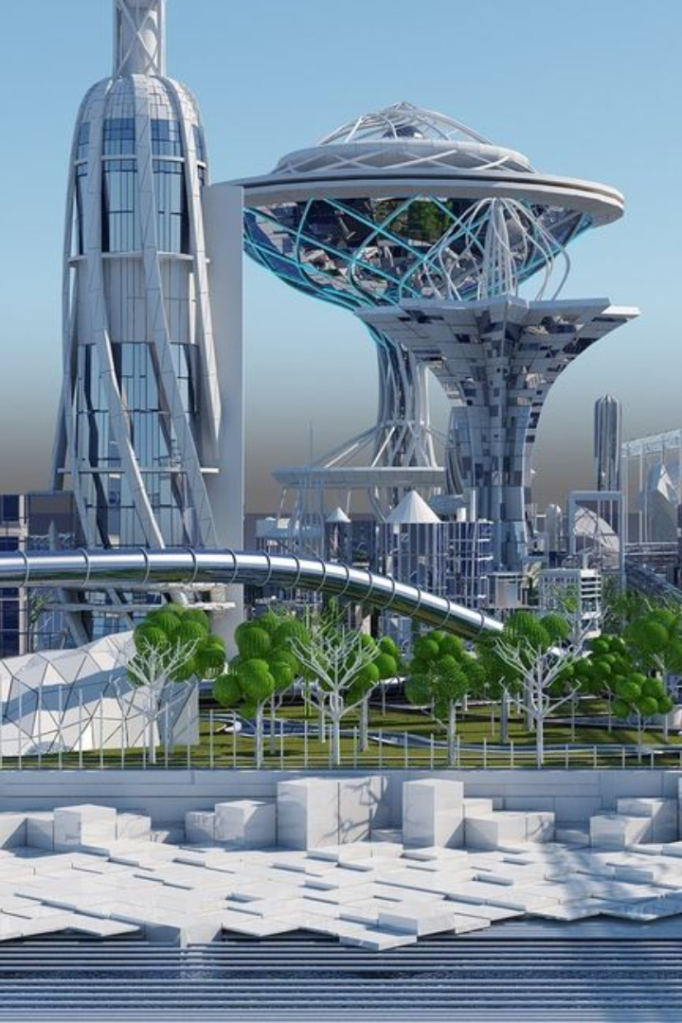
Future Recommendations
As we look ahead, there are several crucial aspects to consider for future development and expansion. Let's explore some intriguing possibilities and strategies for continuous improvement.

Slide 2
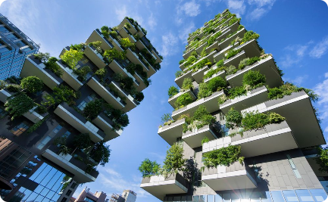

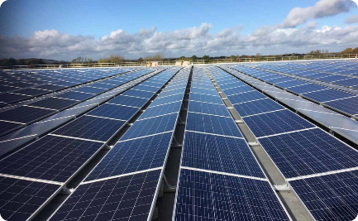
Future Developments and Expansions
Sustainable Design
Smart City Innovations
Renewable Energy Integration
Embrace eco-friendly practices and incorporate sustainable architecture to create environmentally responsible future developments.
Leverage the power of technology and IoT to transform cities into intelligent and connected hubs for enhanced living and efficiency.
Incorporate renewable energy solutions like solar panel rooftops to reduce carbon footprint and create more self-sustaining developments.

Slide 3

Recommendations for Similar Projects
User-Centric Design
Data-Driven Decision-Making
Place the needs and preferences of users at the center of the project, ensuring a seamless and personalized experience.
Utilize data analytics to gather insights and make informed decisions that optimize project outcomes.
Collaborative Partnerships
Forge strong collaborations with industry experts, architects, and stakeholders to leverage diverse expertise and resources.

Slide 4

Continuous Improvement Strategies
1
Regular Evaluation
Evaluate project performance at regular intervals to identify areas for improvement and to maintain alignment with evolving needs.
2
Iterative Design Process
Adopt an iterative design process that encourages feedback and allows for continuous adjustments and refinements.
3
Employee Training & Development
Invest in ongoing training and development programs to enhance the skills and capabilities of the project team.

Slide 5
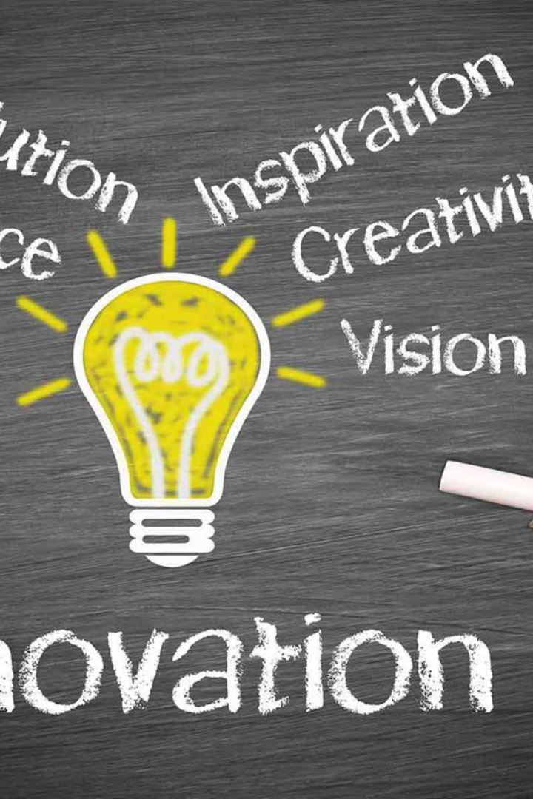
Innovative Thinking: Unleashing the Power of Ideas
Innovation is the key to shaping a successful future. By embracing a culture of creativity and challenging conventional norms, we can unlock groundbreaking solutions.

Slide 6



The Power of Collaboration
Embracing Diversity
Collaborative Environment
Strategic Partnerships
By embracing diversity, we foster unique perspectives and experiences that fuel creativity and drive groundbreaking solutions.
Forge partnerships with external organizations and experts to tap into a wider pool of ideas, resources, and expertise.
Promoting collaboration within teams enhances communication, stimulates innovation, and fosters a sense of shared responsibility.

Slide 7

Adapting to Change: Agile Strategies
1
Flexibility
2
Rapid Prototyping
Embrace flexibility in project planning and execution to adapt to changing market dynamics and emerging opportunities.
Encourage rapid prototyping and testing to validate ideas quickly and iterate efficiently based on user feedback.
3
Continuous Learning
Nurture a culture of continuous learning and improvement to stay ahead in an ever-evolving industry.

Slide 8
Driving Impact: Measuring Success
Key Performance Indicators (KPIs)
Data Analysis
Analyze project data to gain insights into performance, identify areas for improvement, and make data-driven decisions.
Establish measurable KPIs that align with project objectives to track progress and ensure successful outcomes.
Stakeholder Feedback
Impact Assessment
Regularly engage with stakeholders to gather feedback, evaluate satisfaction levels, and identify opportunities for enhancement.
Conduct impact assessments to understand the broader implications of the project and make necessary adjustments.

